Slide 1
PSLG
Week 4

Slide 2
Plan
Quick overview of two dimensional arrays and (if ye want) a recap of one dimensional arrays. (Poll)
Since this session is in the afternoon and not all of ye might have access to a PC you can program on,
Then we will go onto practical exercises where :
We split ye up into small groups of 3-4.
We then give each group a short programming problem which will help you practice and remember last weeks material.
Myself and Tomek then go between the groups and help ye out if you’re stuck with anything.
No pressure to finish the programming problems during the session.

Slide 3
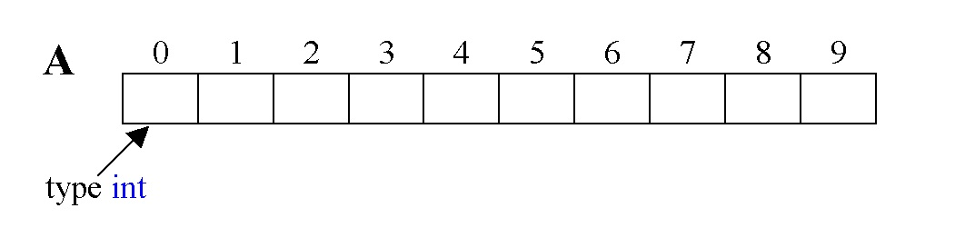
One Dimensional Arrays
Arrays are used to store lists of data of the same type. E.g. A list of ten integers is written like this : int[] A = new int[10];

Slide 4
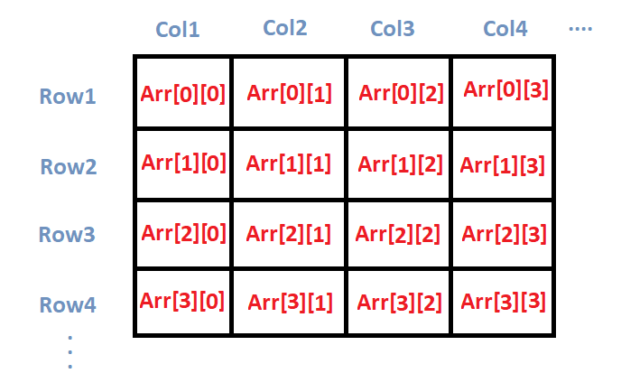
Two Dimensional Arrays
One dimensional arrays resemble one, long row of data like this :
Two dimensional arrays resemble a grid of data :

Slide 5
Two Dimensional Arrays cont.
Declaring a 2D Array:
data_type array_name[][]; (OR) data_type[][] array_name;
Example:
int[][] integer2DArray; // 2D integer array
Initialising a 2D Array:
data_type[][] array_Name = new data_type[no_of_rows][no_of_columns];
Example:
int[][] 2dIntArray = new int[4][4];

Slide 6
Two Dimensional Arrays cont.
Accessing variables in a 2D Array:
You can access any variable in a 2D array using a row number and a column number
Example:
int x = int2dArray[2][3]
This gets you the integer which is in the 3rd row and 4th column of the 2d array because *the first index of an array is 0*

Slide 7
Problem #1
Given an array of N integers, sum up all the integers in the array and print the result.
E.g given int[] arr = { 1 , 5 , 7 };
The answer is 1 + 5 + 7 = 13

Slide 8
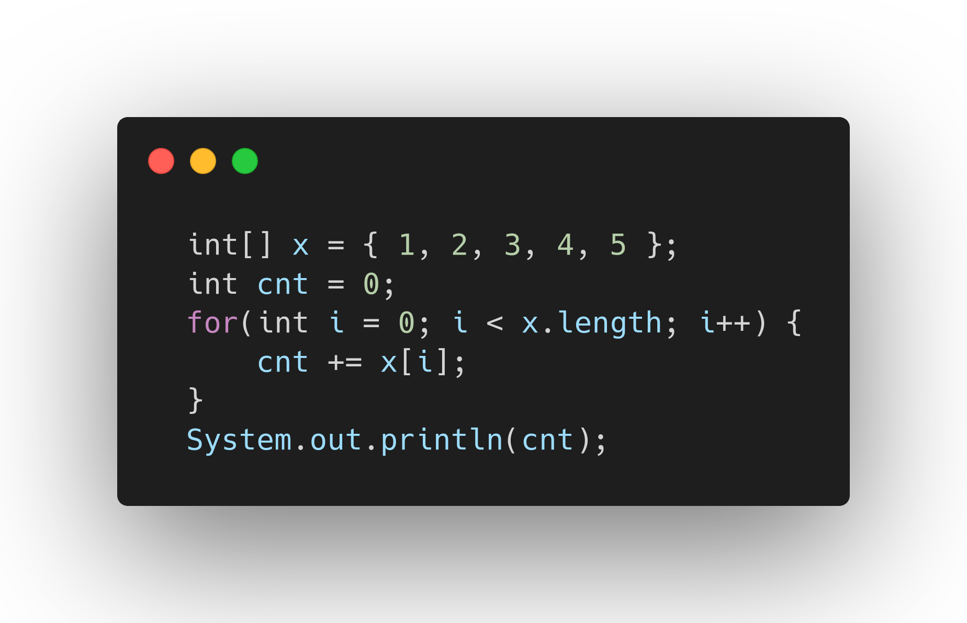
Example Solution

Slide 9
Problem #2
Find the largest number in a two dimensional array of integers.

Slide 10
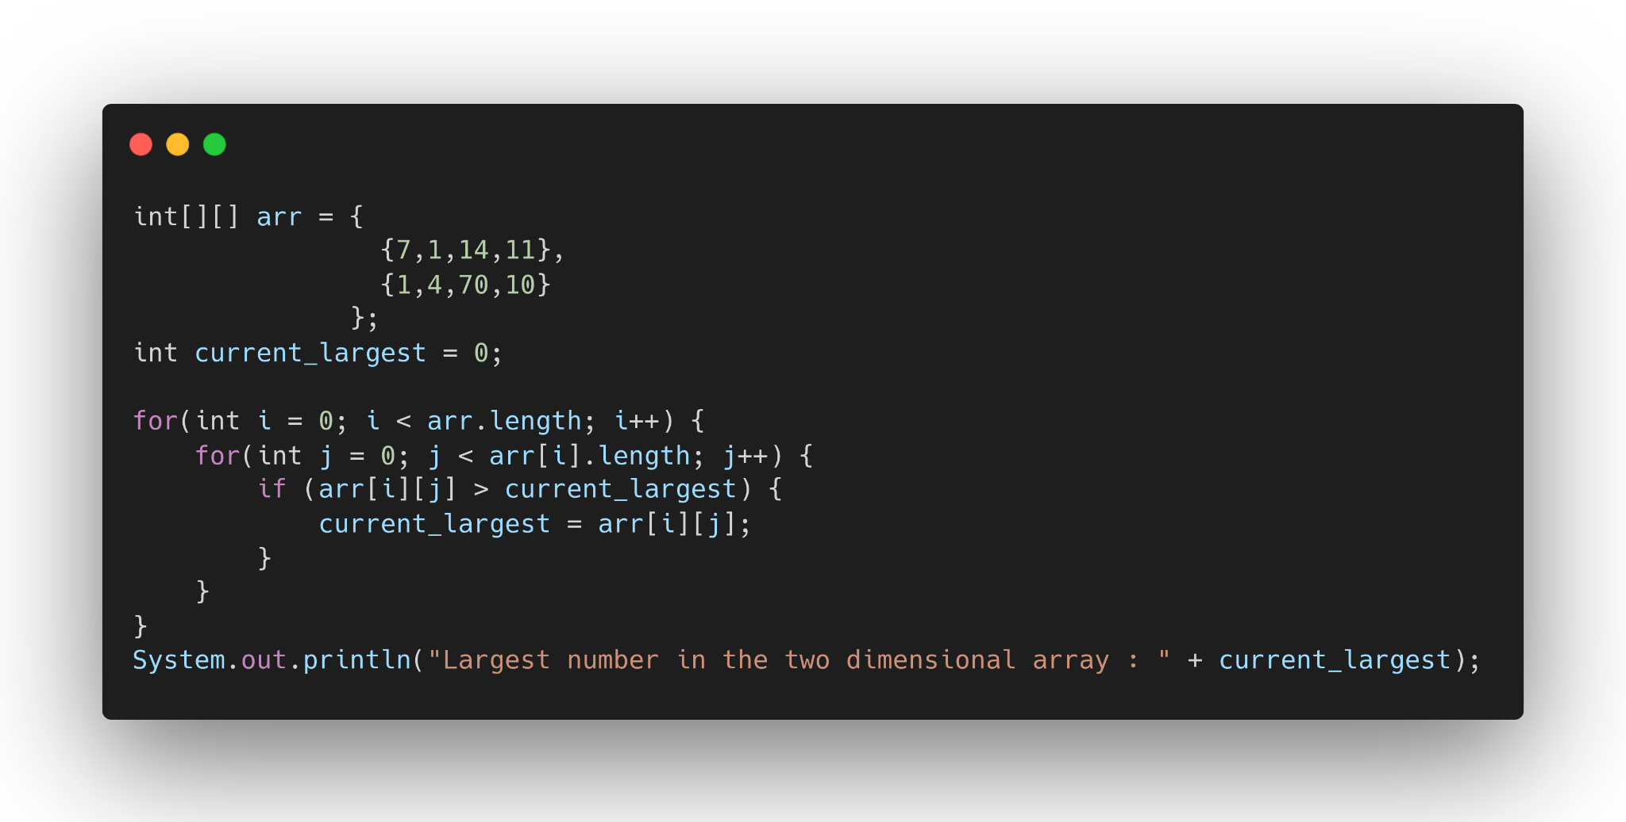
Example Solution

